Slide 1
Public School 174 65-10 Dieterle Crescent Rego Park, NY 11374 Phone (718) 897-7006 ps174.org Mrs. Karin Kelly, Principal Mrs. Kerstin Kobetitsch, A. P. Moving into “Just-Right” Books
By Kindergarten Teachers
For Kindergarten Parents

Slide 2
“Just-Right” Books
Also called:
Leveled Books
“Dot” Books
Children start looking at the print.

Slide 4
Red Dot Books
Level 1 A and B

Slide 5
“A” books have a simple pattern on every page.
example:
Mom is driving.
Mom is painting.
Mom is cooking.
example:
I can run.
I can slide.
I can climb.

Slide 6
“B” books have one page that does not follow the pattern.
example:
Mom is driving.
Mom is painting.
I love my mom.
example:
I can run.
I can slide.
I can play in the playground.

Slide 7
As your child reads an A/B Book they should be able to:
Use the pattern.
Point under each word.
Use the pictures to help them read.
They are NOT sounding out words at this level.

Slide 8
A and B Get Ready to Read
Look at the cover together.
Ask: “What do you think this book will be about?”

Slide 9
Helping your child read an A/B book:
An adult reads the first page to the child.
An adult shows how to point under each word.

Slide 10
As they read,kids are NOT “sounding out” words in Levels A/B. These are things you can say:
“Use the pattern.”
“Point under each word.”
“Look at the picture.”
“Does that make sense?”

Slide 11
Comprehension
“WHAT WAS THIS BOOK ABOUT?”

Slide 12
Green Dot Books
Level 2 C and D

Slide 13
C /D Books
Children start using the sounds of letters to figure out “tricky” words.

Slide 14
Students use familiar “sight words”
without help.
(Don’t read them the
first page.)

Slide 15
These are things you can say for a child reading Levels C/D:
“Look at the picture for clues.”
“Look at the first (and last) letter.”
“Get your mouth ready to say that sound.”
“Does that make sense?”

Slide 17
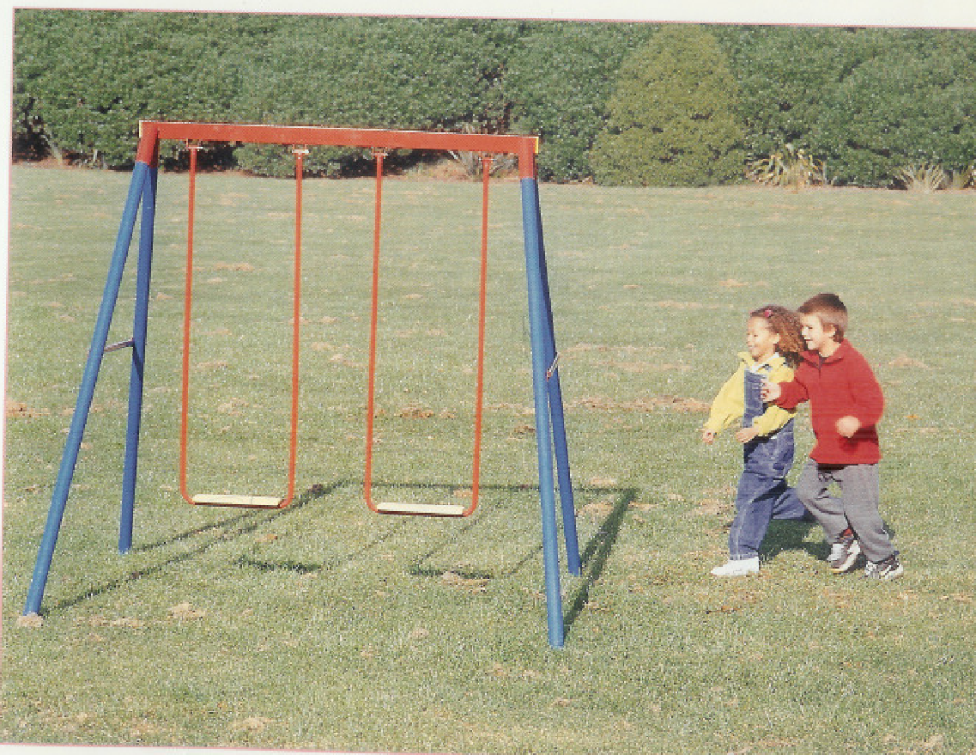
We are going to play on the swings.

Slide 18
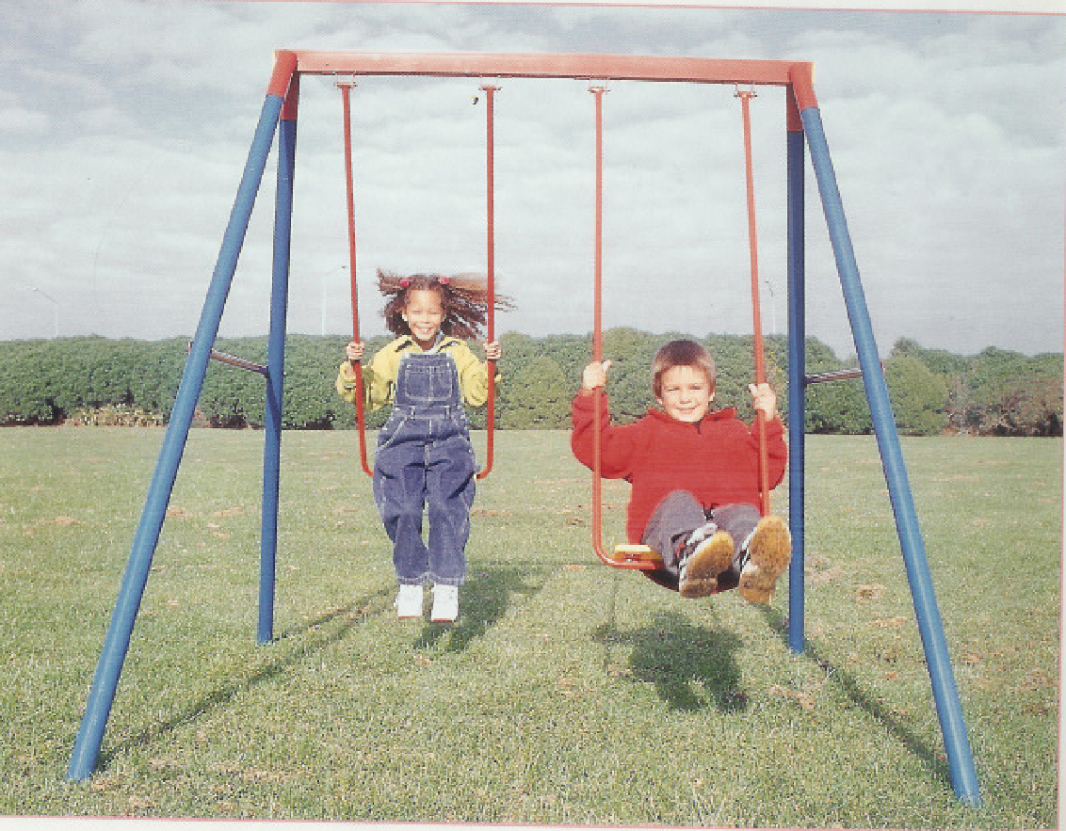
We like playing on the swings.

Slide 19
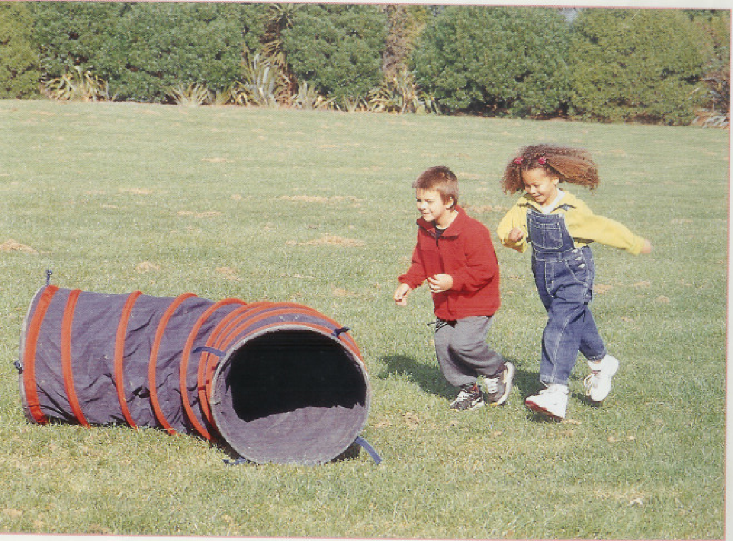
We are going to play in the tunnel.

Slide 20
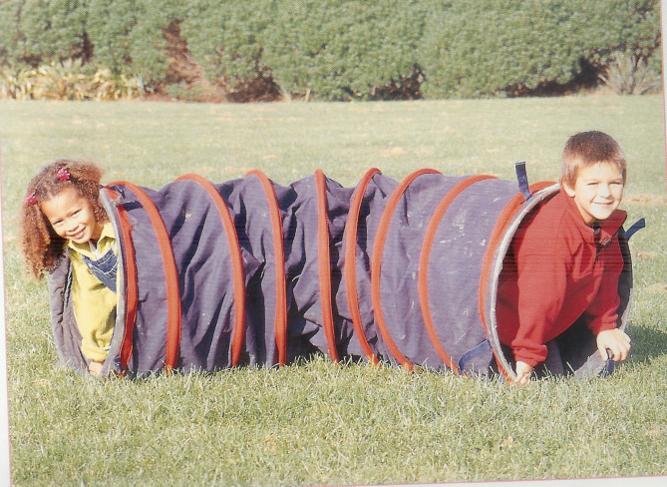
We like playing in the tunnel.

Slide 21
Comprehension
“WHAT WAS THIS BOOK ABOUT?”
Children cannot move to the next level if they cannot discuss the book.

Slide 22
What level is my child?
Children are assessed (tested) to determine what level is “just right.”
This includes
reading the words
and
demonstrating comprehension
You will receive a letter from your child’s teacher indicating their current reading level.

Slide 23
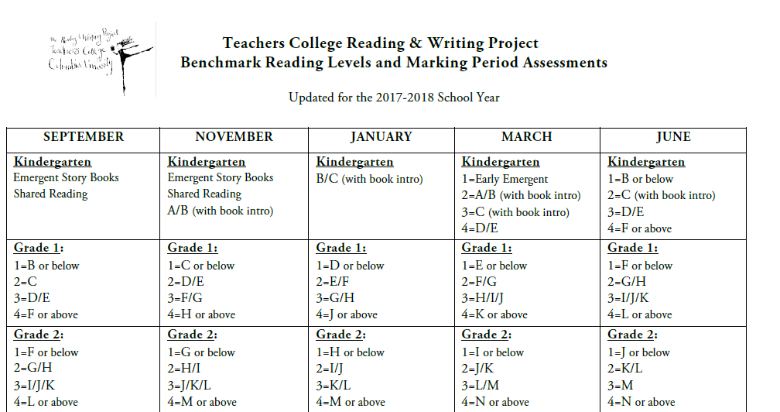
What level meets the standards? (Don’t worry, the next page will explain this chart.)

Slide 24
What does that chart mean? What level meets the standards?
In January, students who are level B/C (with book intro) are meeting proficiency standards.
By March, the expectation is for students to read at level C (with book intro).
In June, students who are in levels D/E green dot books are meeting kindergarten standards.

Slide 25
THANK YOU FOR COMING!
We hope that hearing
about how we use these books
has helped you
so you can help your child
become a stronger reader!

