Slide 1
NYS 4th Grade Science Exam
March 5th, 2019
Presenter: Len Pizza

Slide 2
Structure of Exam
Performance Assessment (3 Stations)
Measurement
Electricity & Magnetism
Kinetic Energy and Force
Written Assessments (2 Parts)
30 Multiple Choice Questions
12-15 Short Answer Questions

Slide 3
Testing Dates
Performance Assessment
Wednesday, May 22nd – Friday, May 31st (One Day Only)
Written Assessment
Monday, June 3rd (One Day Only)
Make-up Assessment, June 4th – June 7th

Slide 4
Performance Assessment
The performance assessment consists of 3 hands-on scientific investigations/tasks that will check the students ability to measure, test, estimate and predict using scientific reasoning and their knowledge of scientific concepts.
Each student will work alone and is responsible to complete all 3 stations.
Students are provided a total of one hour to finish all 3 stations.

Slide 5
Performance Task 1

Slide 6
Performance Task 2

Slide 7
Performance Task 3

Slide 8
Written Assessment
The written assessment consists of 30 multiple choice questions and 12-15 short answer questions. Students will apply their knowledge of scientific concepts, formulate hypotheses and make predictions.
No time limit for the written assessment.

Slide 9
Multiple Choice Question

Slide 10
Multiple Choice Question

Slide 11
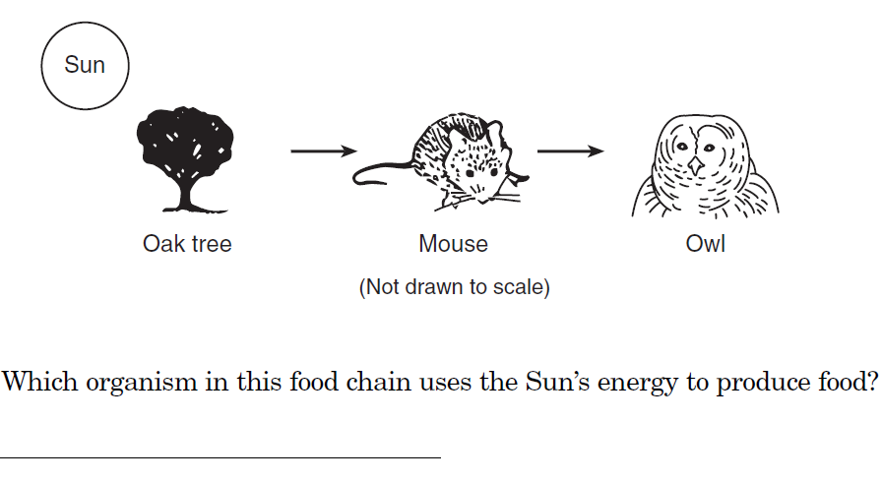
Short Answer Example

Slide 12
Short Answer Example

Slide 13
Exam Preparation
Students receive a quality science education here at P.S. 174 from kindergarten through 5th grade. The classroom teachers are utilizing text books and workbooks. In addition, the students have access to a vast amount non-fiction resources in the classroom library.
Students are receiving a STEM education which provides them with a rich, more in depth, hands-on approach to learning science.

Slide 14
Exam Preparation
Students and parents can access years of past exams that have been given by NYS at: http://www.nysedregents.org/Grade4/Science/home.html . Students will become familiar with the structure of the test and gain practice answering questions.
The following is an interactive online application that presents past science exam questions in a game show format. Many students really seem to enjoy this approach to test prep. http://www.quia.com/rr/66818.html?AP_rand=2048183830

Slide 15
Additional Resources
Barron's New York State Grade 4 Elementary-Level Science Test by Joyce Thornton Barry and Kathleen Cahill

