Slide 1
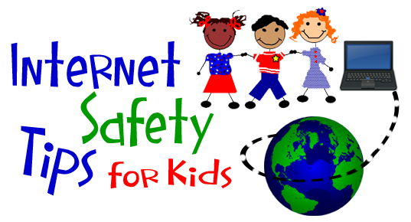
WELCOME PARENTS Public School 174 William Sidney Mount
January 15, 2019 Mr. Pizza (Lpizza2@schools.nyc.gov) Ms. Gruber (Agruber@schools.nyc.gov)

Slide 2
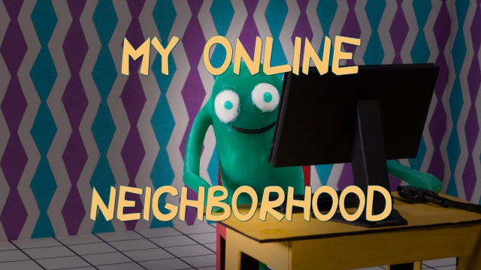
Grades K-2 Video: Going Places Safely K-2 SAFETY RULES 1: Always ask your Parent or Teacher first. 2: Only talk to people you know. 3: Stick to places that are just right for you. Discussion: People have feelings even if you are talking with them and cannot see their face.
Overview of “Common Sense” Lessons

Slide 3
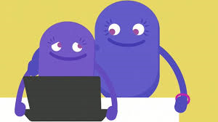
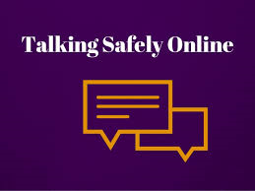
Overview of “Common Sense” Lessons CommonSense.org
Grades 3-5 Video: The Power of Words
The proper thing to do if someone uses aggressive language on the Internet - tell a trusted adult.
Video: Talking Safely Online Who is safe to talk to online?

Slide 4
What’s Out There?

Slide 5
Cyberbullying 101
Cyberbullying 101
Enough.org

Slide 6
New York City Department of Education recommendation
Parents best resource for all internet/media safety

Slide 7
If there are any questions, please email LPizza2@schools.nyc.gov

